Slide 1
Capstone Project 4
Online Retail Customer Segmentation
Kiran Ahire

Slide 2
Points for Discussion
Business Objective
Data Summary
Feature Summary
Data Preprocessing
Exploratory Data Analysis
Corelation between data
Algorithms implementation
Conclusion

Slide 3
Business Objective
Customer segmentation is the practice of dividing a company’s customers into groups that reflect similarity among customers in each group. The goal of segmenting customers is to decide how to relate to customers in each segment in order to maximize the value of each customer to the business.
Customer segmentation has the potential to allow marketers to address each customer in the most effective way. Using the large amount of data available on customers (and potential customers), a customer segmentation analysis allows marketers to identify discrete groups of customers with a high degree of accuracy based on demographic, behavioral and other indicators.
Given the dataset, our objective is to build clustering model that would perform Customer Segmentation.
ly of rental bikes.

Slide 4
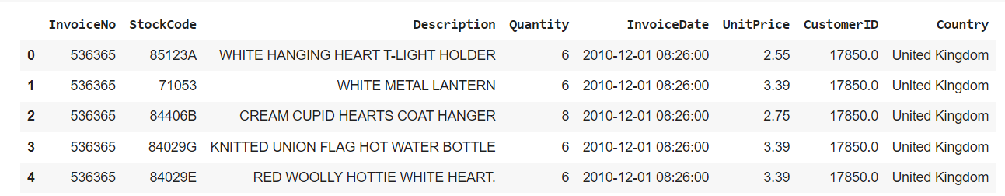
Data Summary
There are total 541909 rows and 8 columns in our dataset.
This is a transnational dataset with transactions occurring between 1st December 2010 and 9th December 2011 for UK based online retailer.
Many customers of the company are wholesalers.

Slide 5
Feature Summary
We have given the following information in our dataset:
InvoiceNo: Invoice number. Nominal, a 6-digit integral number uniquely assigned to each transaction. If this code starts with letter 'c', it indicates a cancellation.
StockCode: Product (item) code. Nominal, a 5-digit integral number uniquely assigned to each distinct product
Description: Product (item) name. Nominal.
Quantity: The quantities of each product (item) per transaction. Numeric.
InvoiceDate: Invice Date and time. Numeric, the day and time when each transaction was generated.
UnitPrice: Unit price. Numeric, Product price per unit in sterling.
CustomerID: Customer number. Nominal, a 5-digit integral number uniquely assigned to each customer.
Country: Country name. Nominal, the name of the country where each customer resides.

Slide 6
Data Preprocessing
The dataset contains 541909 rows and 8 columns
There are 4 categorical features namely ‘InvoiceNo’ , ‘StochCode’,’Country’ and ‘Description’
There are missing values present in ‘Description’ and ‘CustomerID’ columns and removed null values.
There are duplicate values present so removed them.
One Datetime feature ‘InvoiceDate’
Outliers present in ‘Quantity’ and ‘UnitPrice’ column.
Removed cancelled orders
Added new features from Datetime columns such as ‘Day’, ’Month’ and ’Hour’
Added new feature ‘Total Amount’

Slide 7
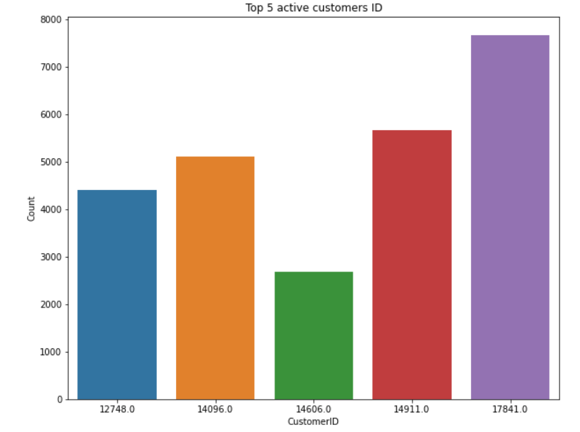
Analysis of CustomerID
There are 4339 unique Customers id.
Customer with id 17841 is the most
Active customer.
Notes:
A dependent variable is a variable whose value will change depending on the value of another variable. In out dataset, Our dependent variable is "default_payment_next_month“
In this if Y=0 then not default, Y=1 then default".

Slide 8
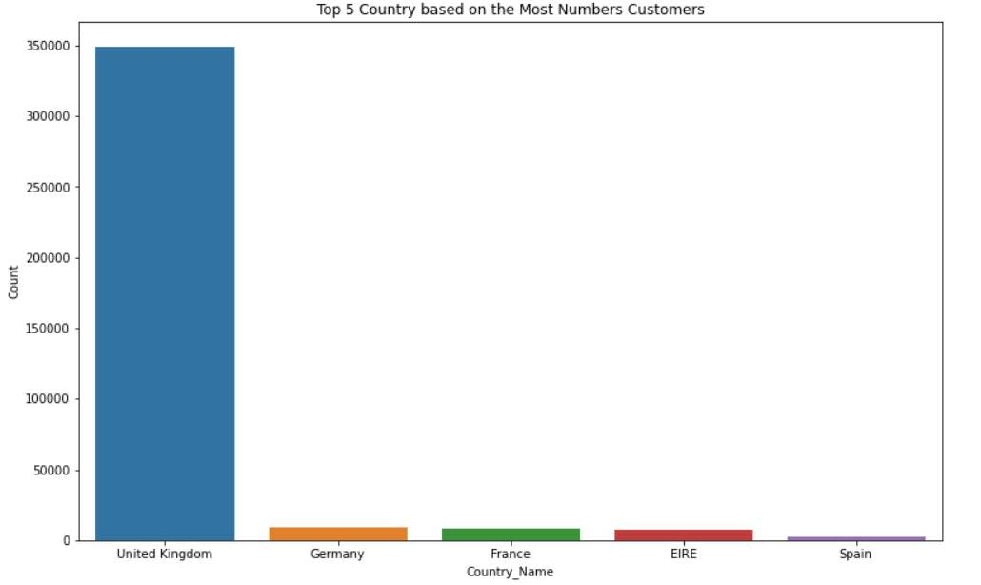
Analysis of Country
Since the Data belonged to UK
company, UK had majority
of the customers.
UK , Germany and France were
top countries having most no.
of customers.

Slide 9
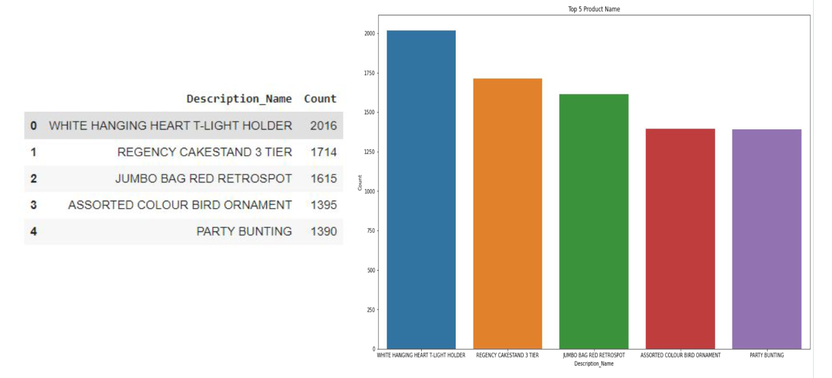
Analysis of Description

Slide 10
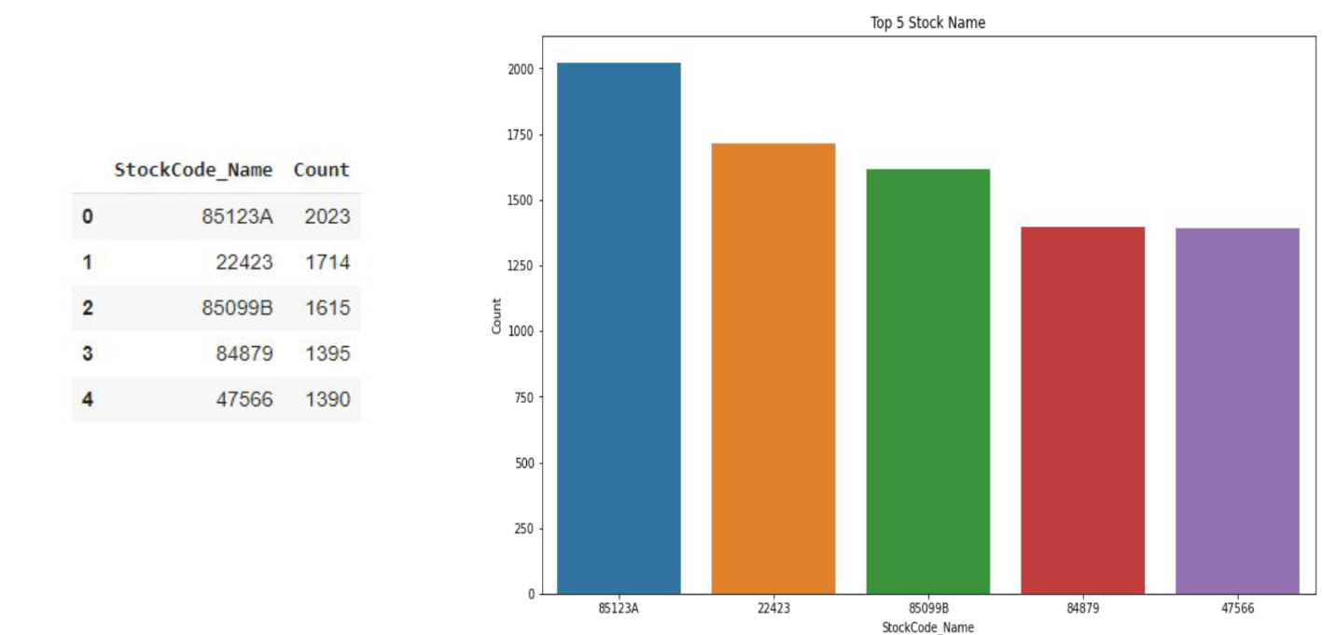
Analysis of StockCode

Slide 11
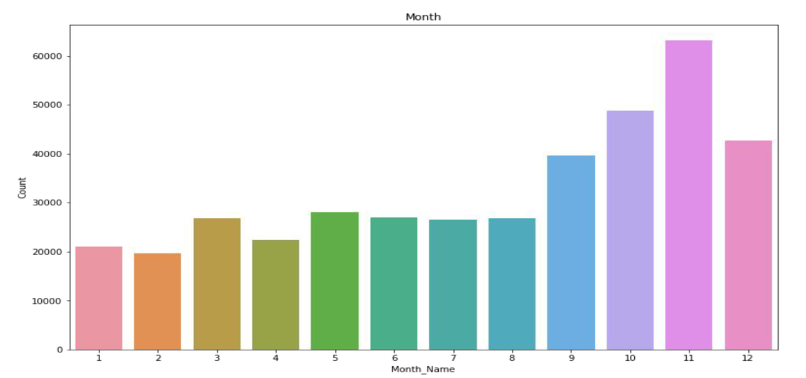
Analysis of Month
November month has highest sales followed by October and December.

Slide 12
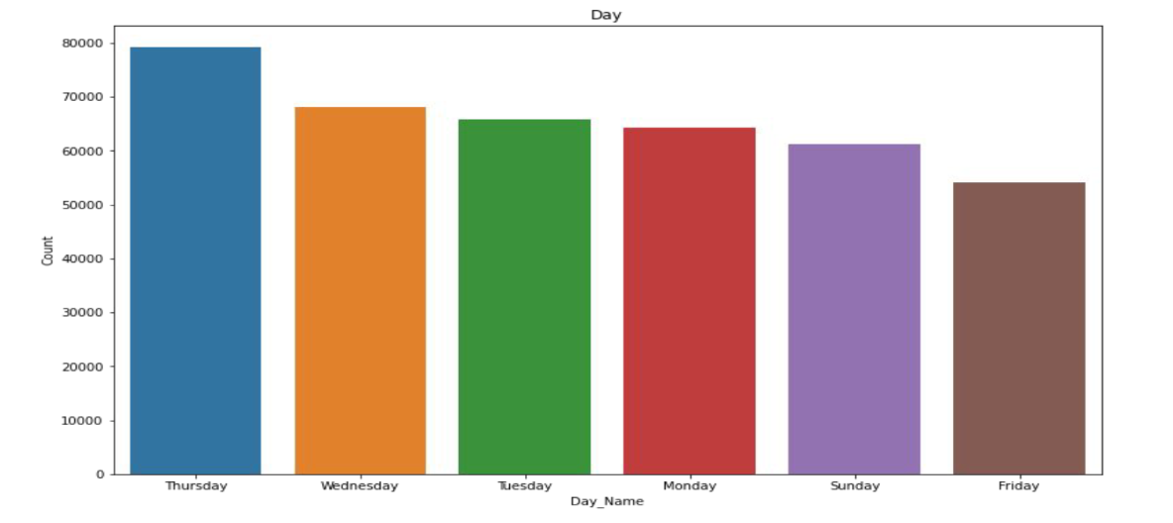
Analysis of Day
Most of the customers have purchased items on Thursday , Wednesday and
Tuesday.

Slide 13
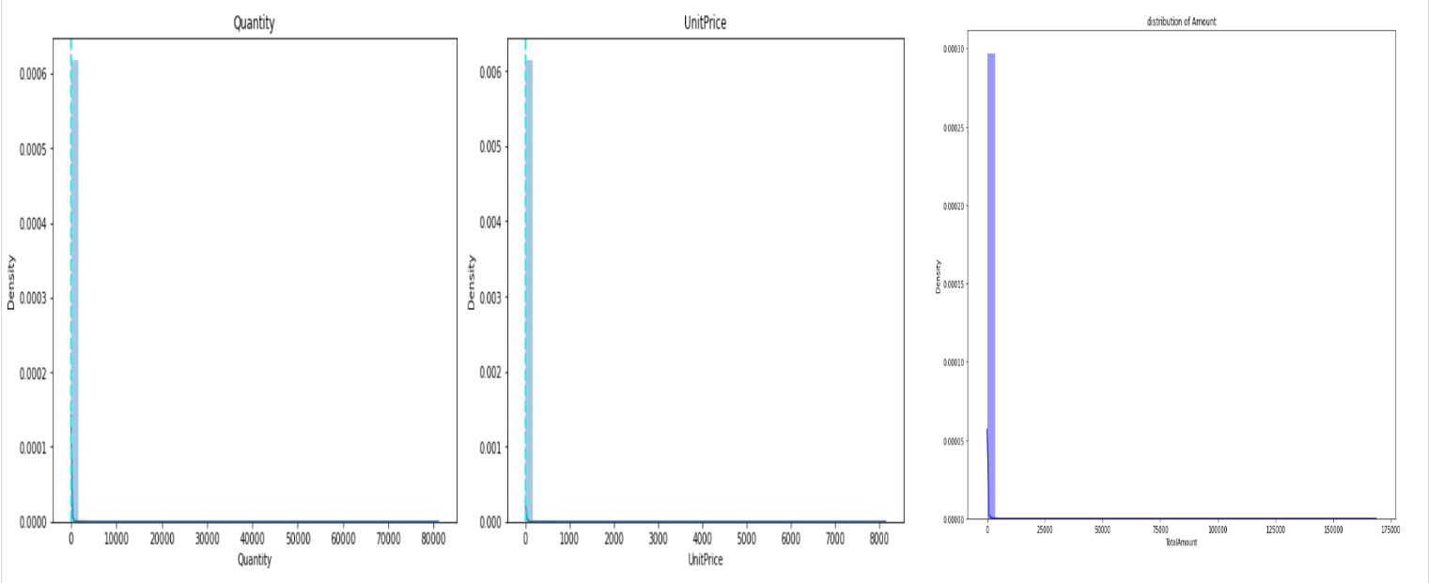
Analysis of Numerical variable
Highly positively skewed data we need to do log transformation.

Slide 14
RFM Model
RFM model which stands for Recency, Frequency, and Monetary is one of such steps in which we determine the recency - days to last visit, frequency - how actively the customer repurchases and monetary - total expenditure of the customer, for each customer
RFM analysis allows marketers to target specific clusters of customers with communications that are much more relevant for their particular behavior – and thus generate much higher rates of response, plus increased loyalty and customer lifetime value.
Recency = Latest Date - Last Inovice Data,
Frequency = count of invoice no. of transaction(s),
Monetary = Sum of Total Amount for each customer

Slide 15
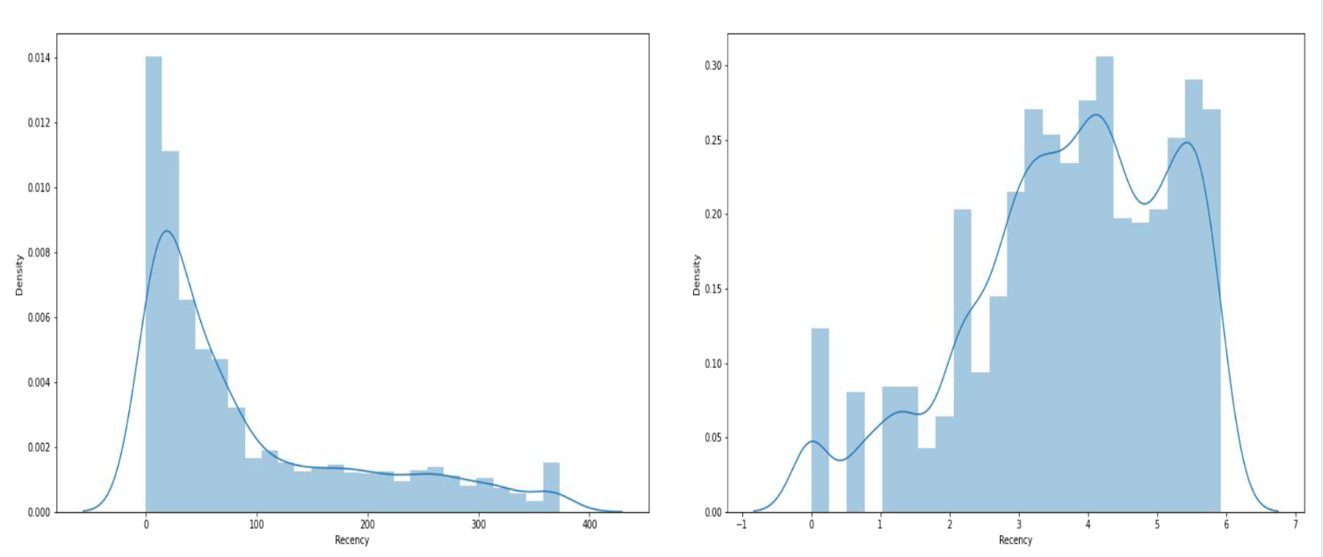
Recency

Slide 16
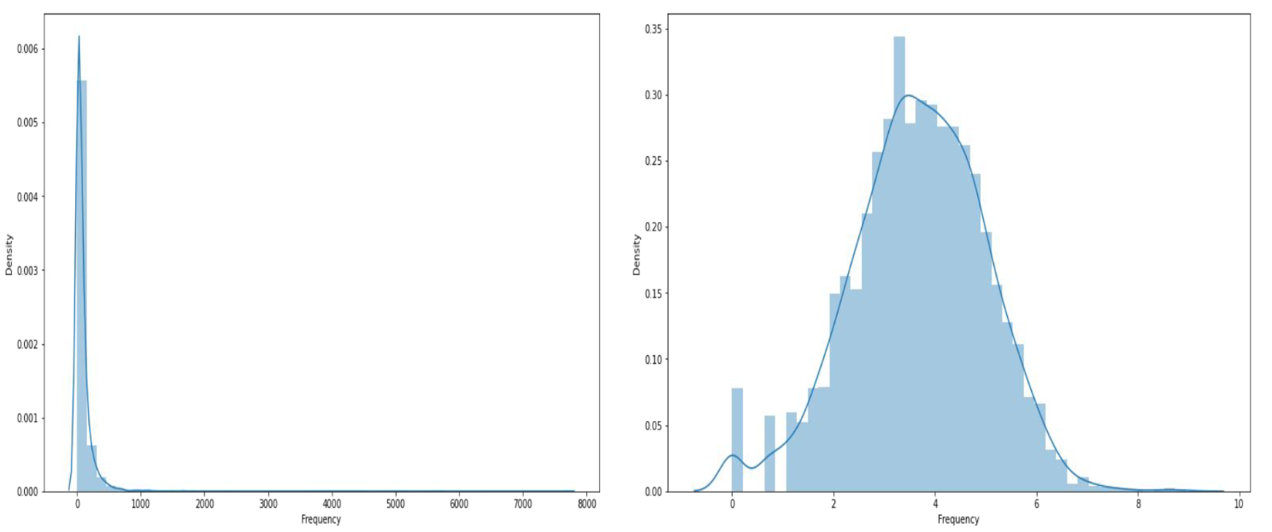
Frequency

Slide 17
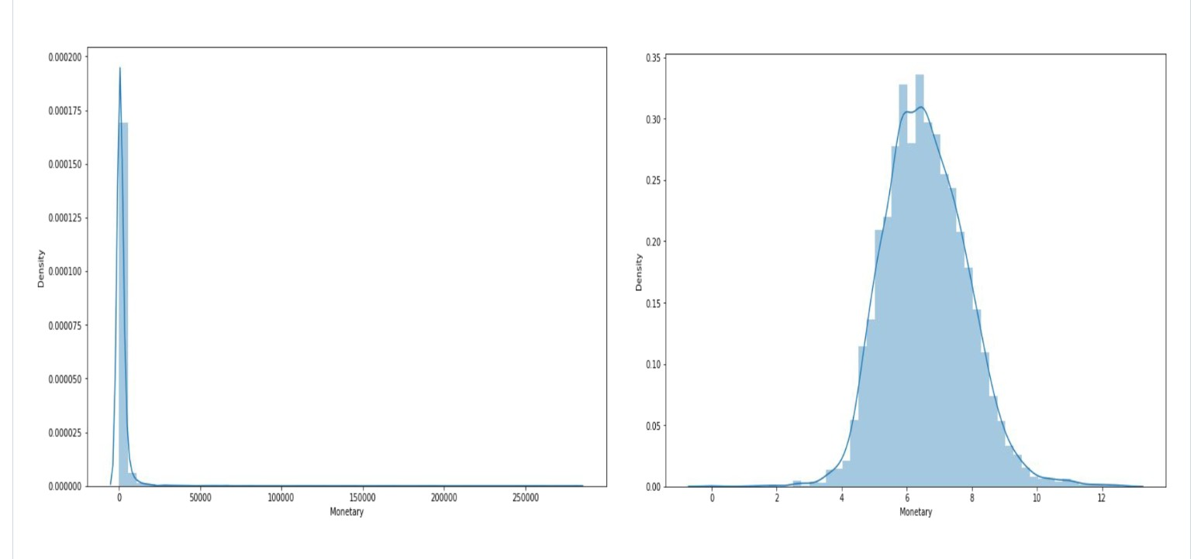
Monetary

Slide 18
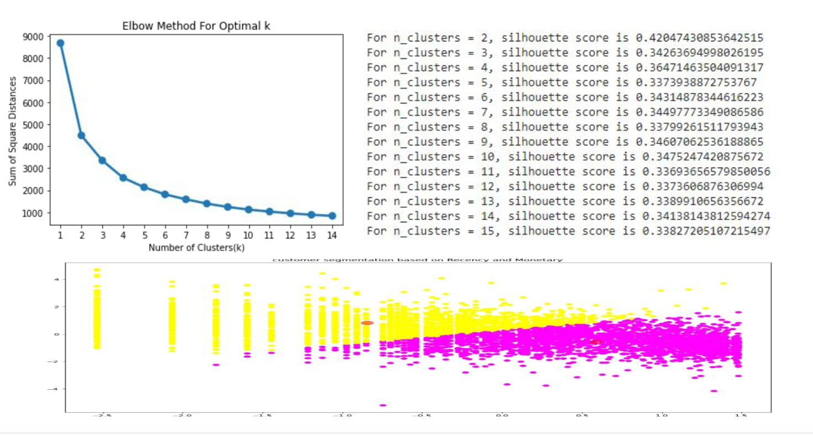
Silhoutte score and Elbow method on R&M

Slide 19
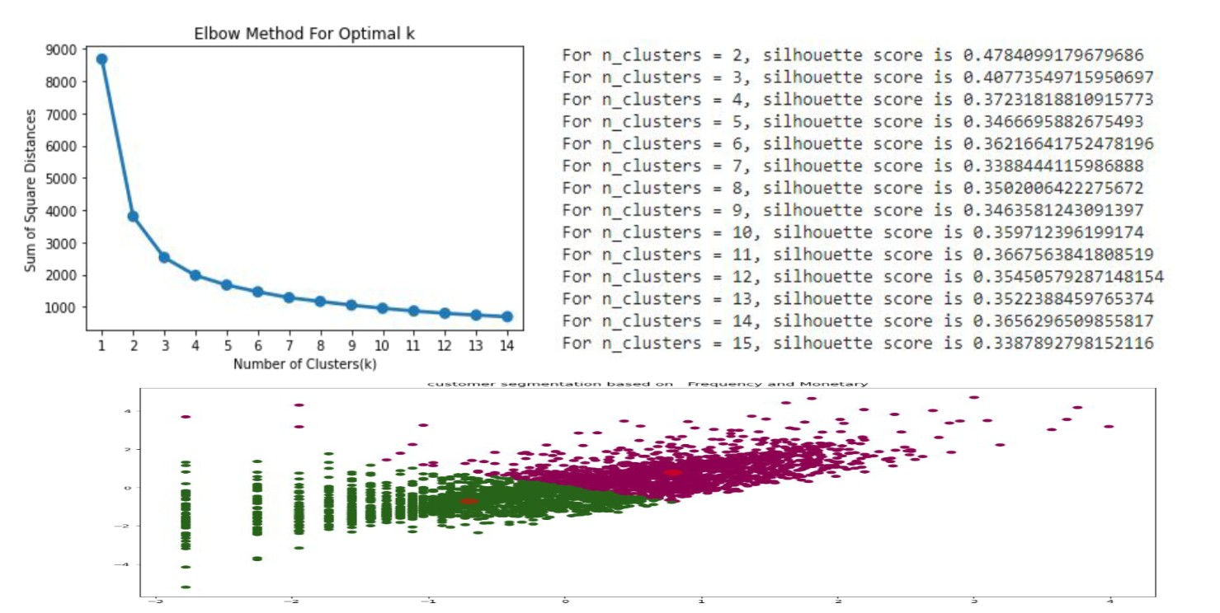
Silhoutte score and Elbow method on F&M

Slide 20
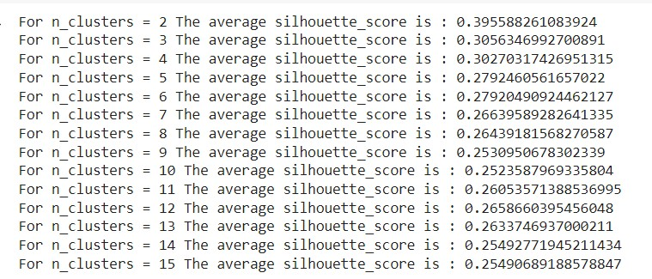
Silhoutte score on R , F & M

Slide 21
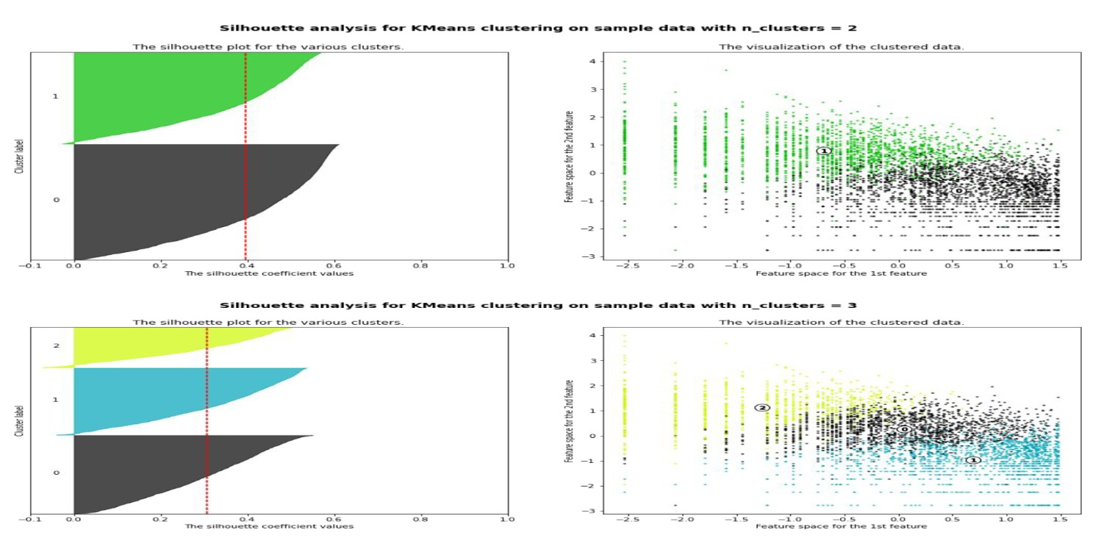
Silhoutte Analysis on R , F & M

Slide 22
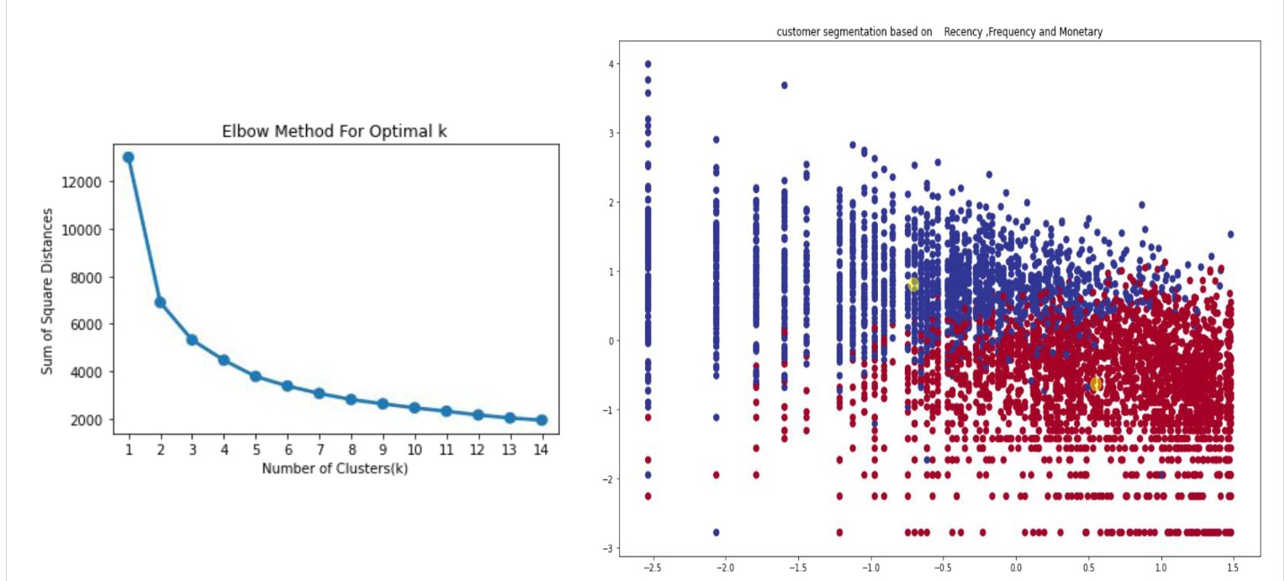
Elbow method and cluster chart on RFM

Slide 23
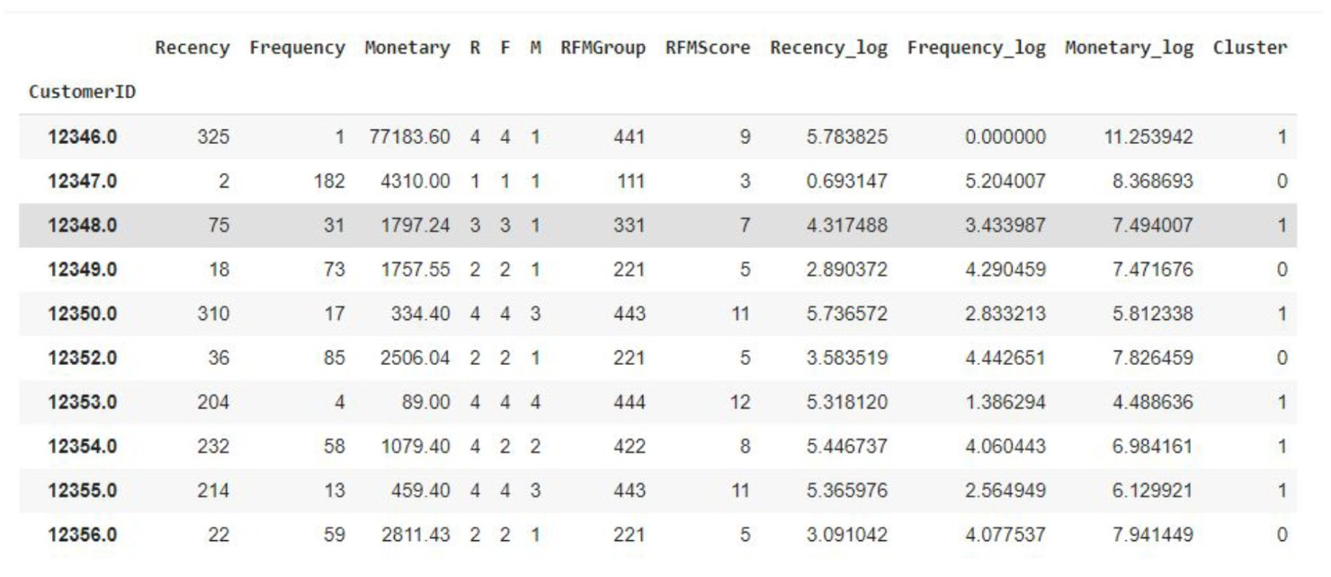
RFM Analysis

Slide 24
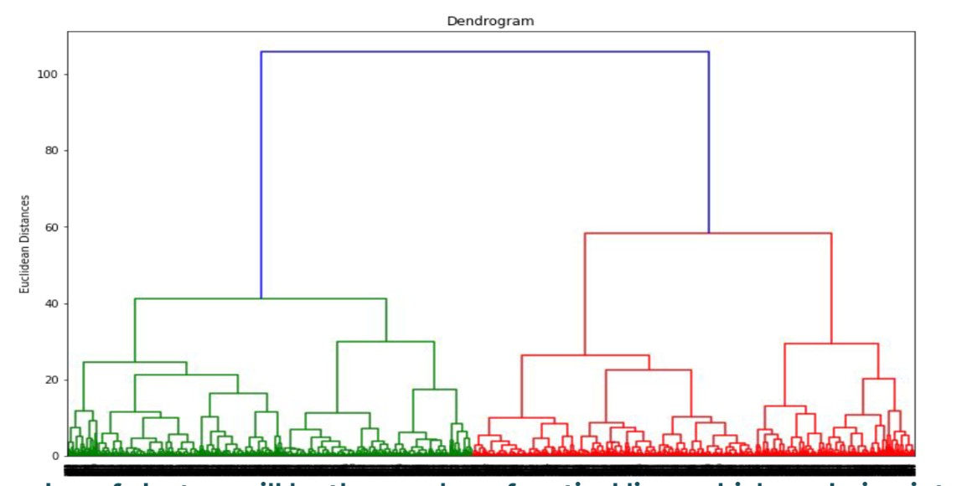
Hierarchical Clustering
The number of clusters will be the number of vertical lines which are being intersected by the line drawn using the threshold=90
No. of Cluster = 2

Slide 25
Conclusion
Throughout the analysis we went through various steps to perform customer segmentation. We started with data wrangling in which we tried to handle null values, duplicates and performed feature modifications. Next, we did some exploratory data analysis and tried to draw observations from the features we had in the dataset.
Then, we formulated some quantitative factors such as recency, frequency and monetary known as rfm model for each of the customers. We implemented KMeans clustering algorithm on these features. We also performed silhouette and elbow method analysis to determine the optimal no. of clusters which was 2. We saw customers having high recency and low frequency and monetary values were part of one cluster and customers having low recency and high frequency, monetary values were part of another cluster.

